Slide 1

Robotics Project
Water borne self
propelled automated
probe.

Slide 2
Android Portion
The code used to communicate with the drone remotely

Slide 3
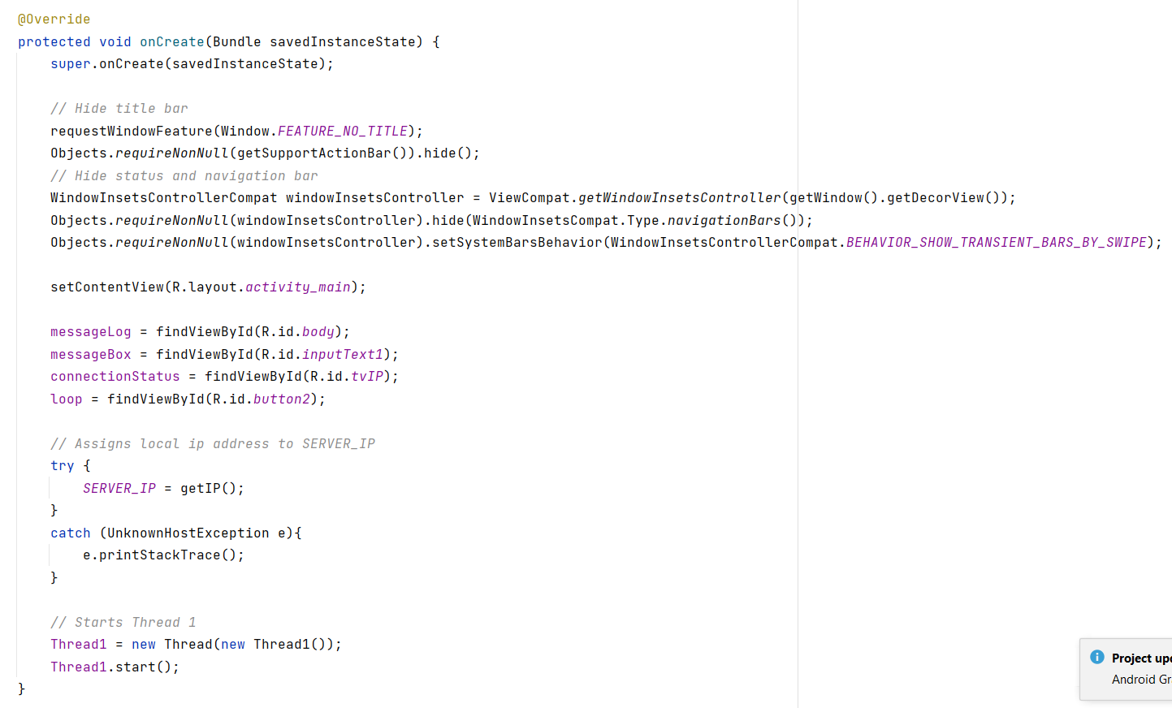
Initiating the app

Slide 4
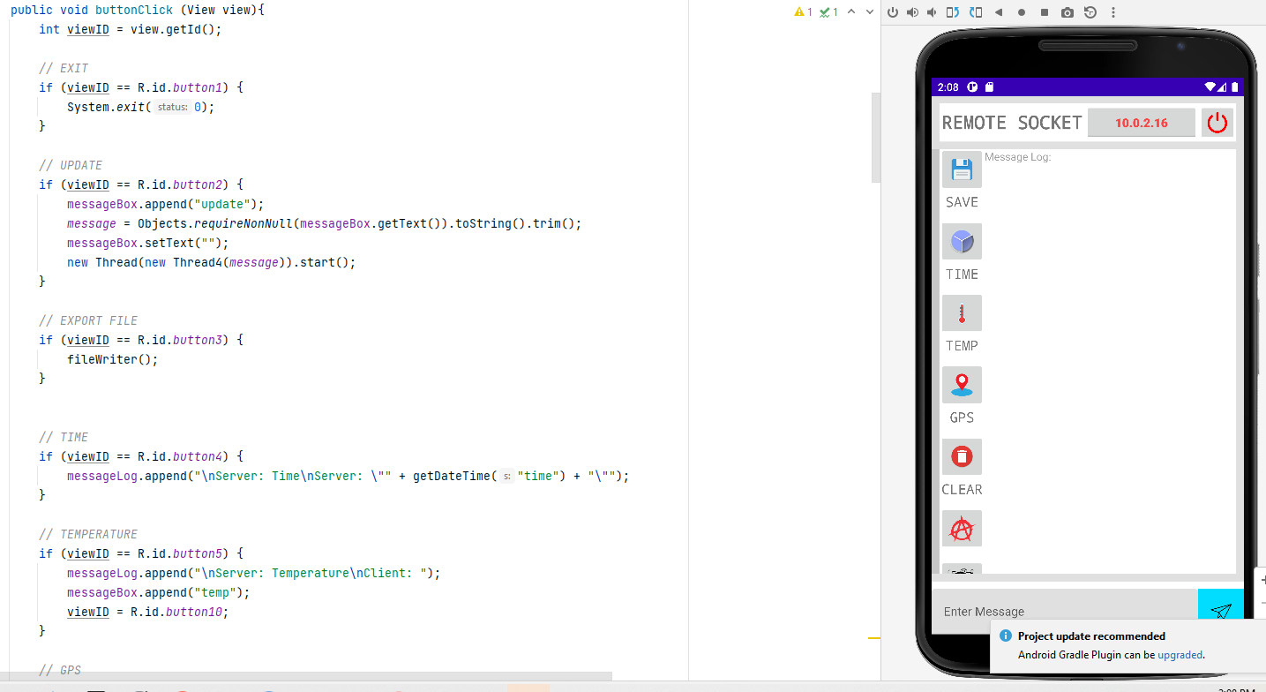
This is where the button magic happens

Slide 5
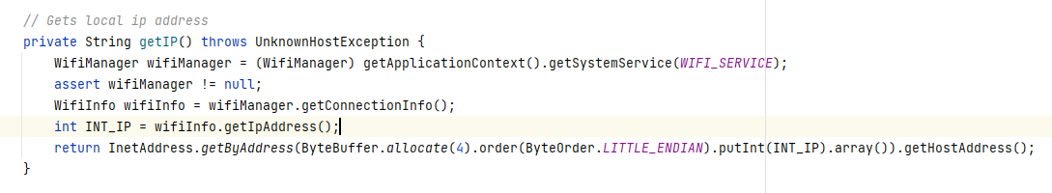
Here we are setting up the environment to get an IP address. This is used to provide the probe with an address to call. Any WIFI can be used given that the ID is known to the probe as well as the Password. Then the IP and port are declared to be listening on the app and the probe. We did not have to use an internet connection because the probe has its own LAN.

Slide 6
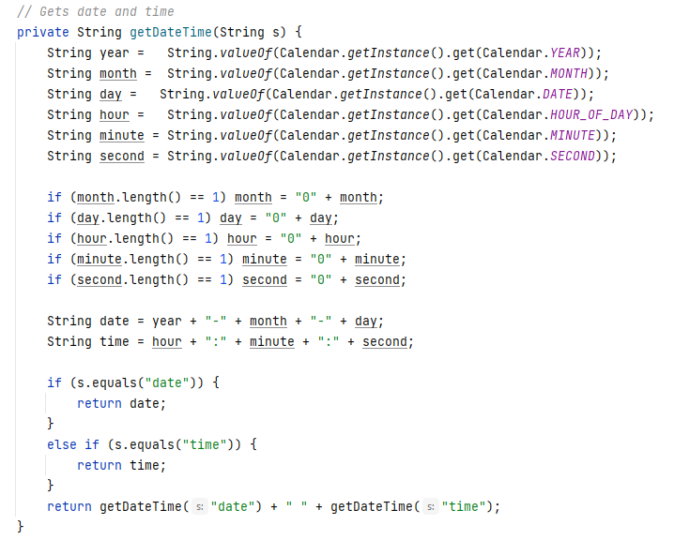
Here is a solution to getting the time and date from android because the microcontroller does not persist or synchronize our standard time.

Slide 7
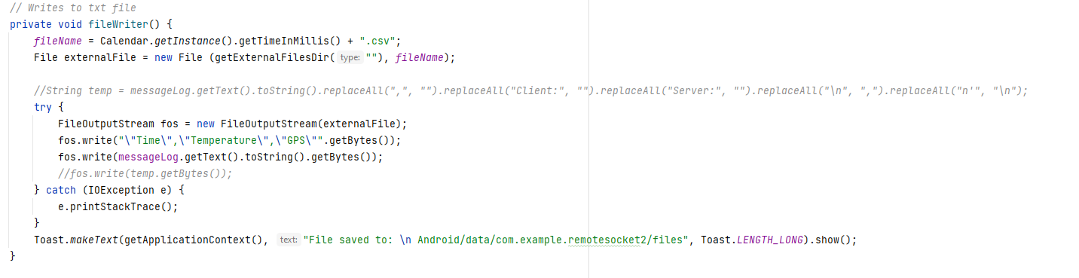
Here we are taking our data and saving it to a comma separated file on the android side

Slide 8
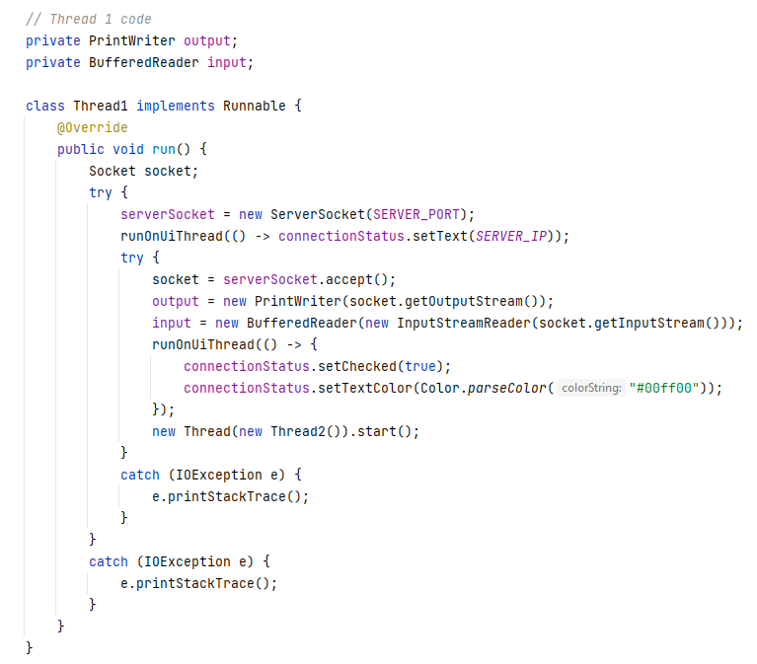
This thread is very important to us. Here we start our process of communicating with the remote device

Slide 9
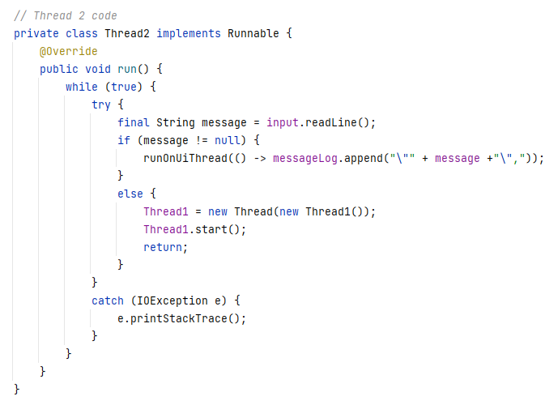
Thread2 is initialized by thread and loops back to it if no message is retrieved. A true thread in the literal sense. They go back and forward to make sure messages get sent and received

Slide 10
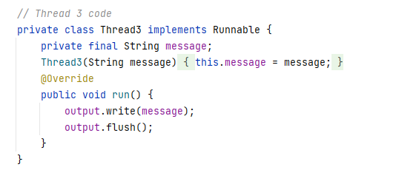
Thread3 is a very smart solution given by Gaurav it may not look like much, but it saves a lot of coding, I think of it as a sort of reverse code factory design. If you go back to the buttons, they all use it.

Slide 11
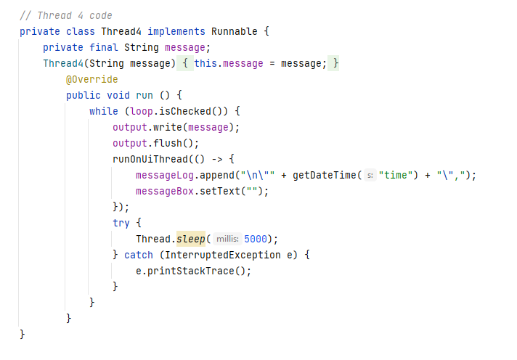
Thread4 is also used by a button it updates the information in a useful visual log in a table format

Slide 12
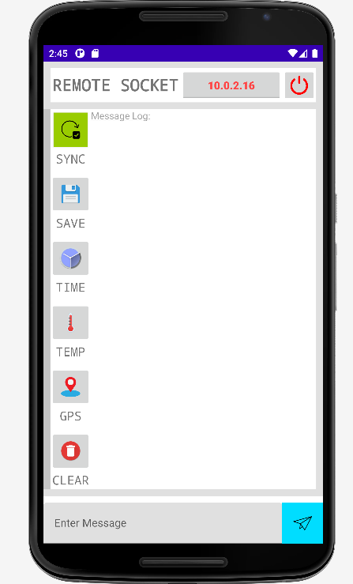
This is our application; it is hard to explain all the cool things it does, but we will demonstrate them with the help of the probe it is meant to operate.

Slide 13
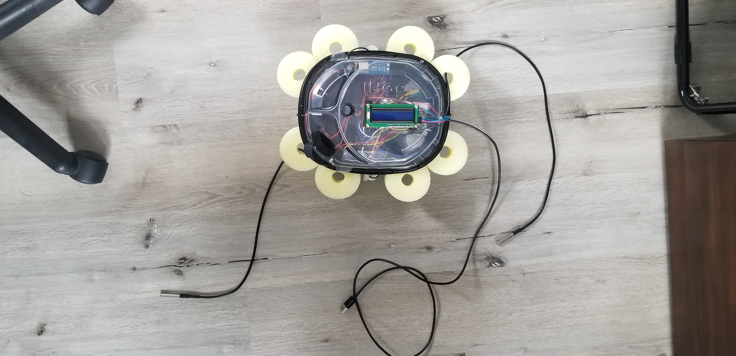
This is our device it has grown since conception. It currently carries a pi Pico microcontroller; a buck down dc converter; 2 motor controllers with capacity for 2 motors each; a WIFI module; a GPS module; two water thermometer sensors; a lcd screen; and 8 little fish tank pumps

Slide 14
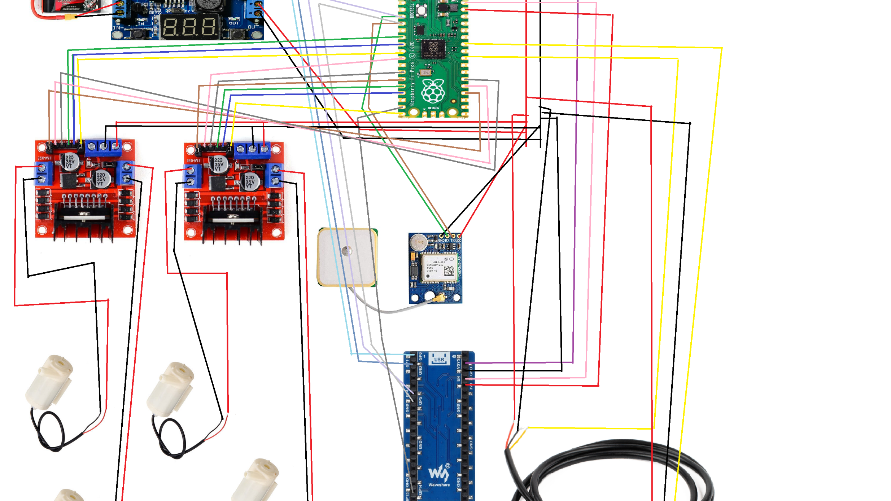
Our probe has grown so much this diagram is missing some parts and need to be updated. But enough with the boring. Let's see it work!!!

Slide 15
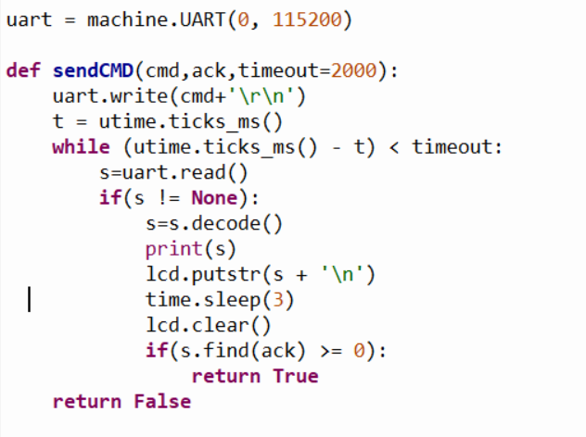
Communication

Slide 16
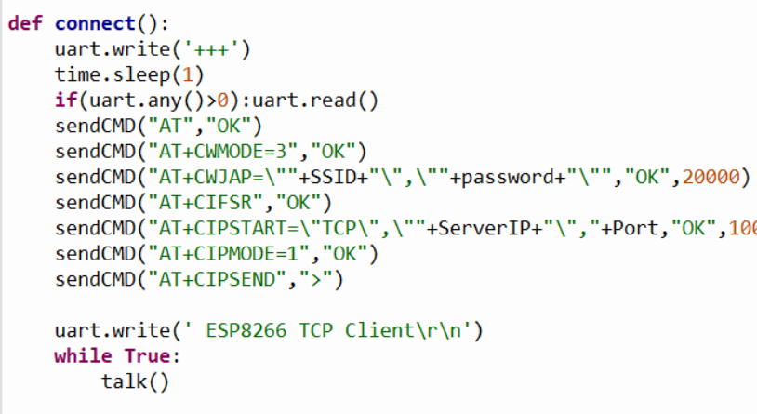

Slide 17
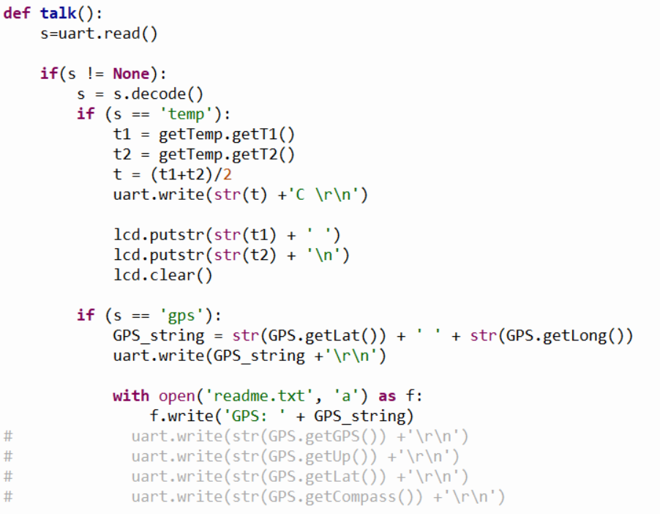

Slide 18

Movement

Slide 19
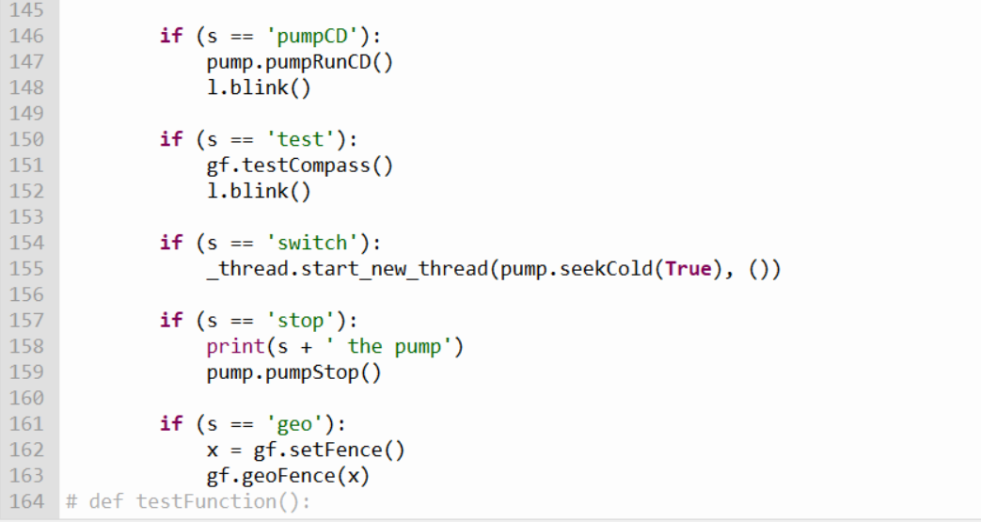
Listening to calls and activating functions

Slide 20
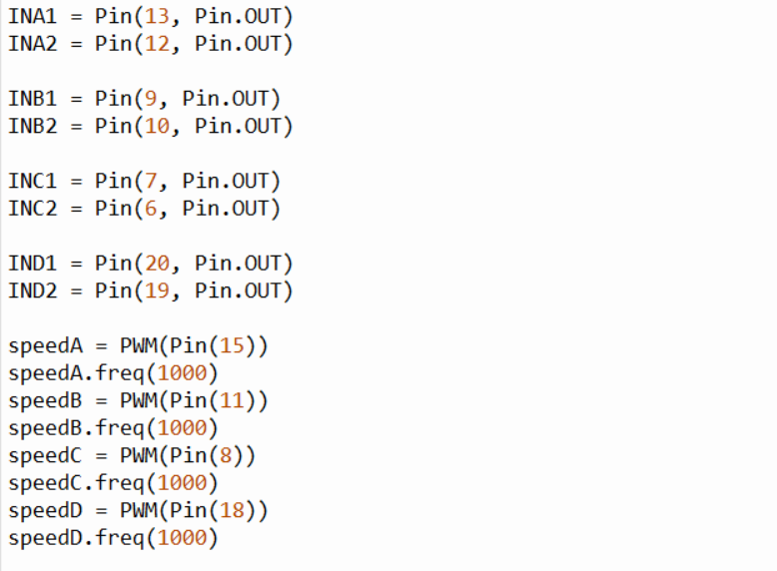
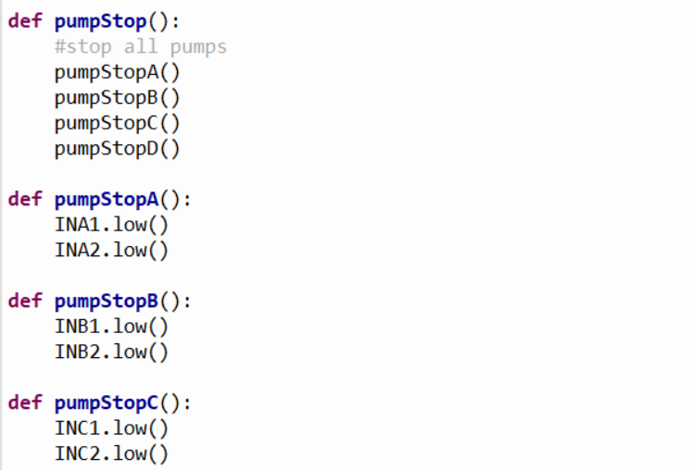
Inside the pump class
Setting up
Calling individually

Slide 21
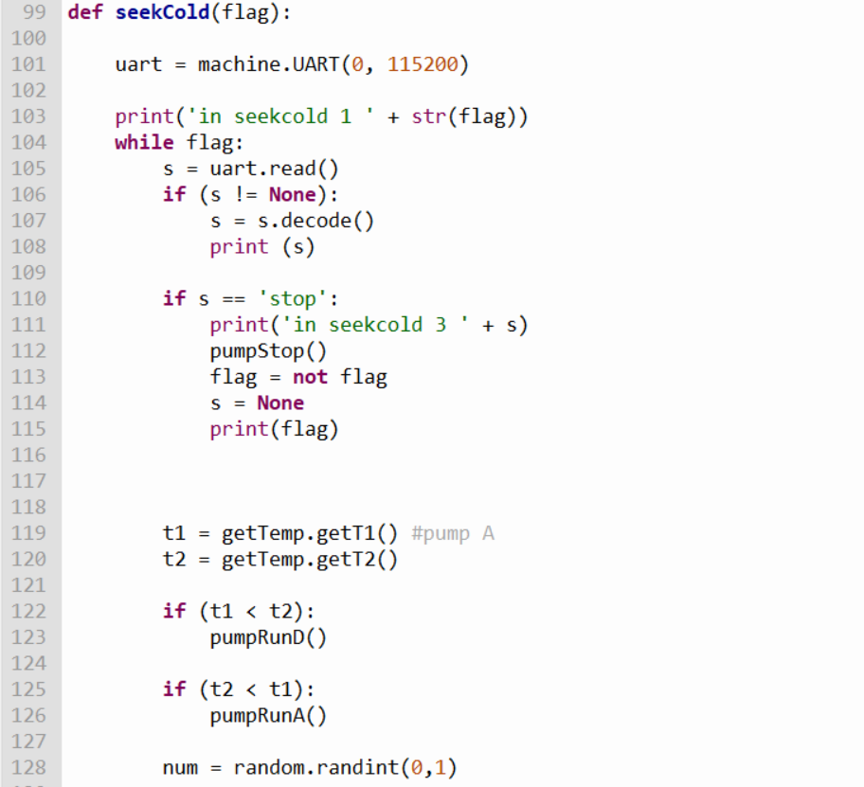
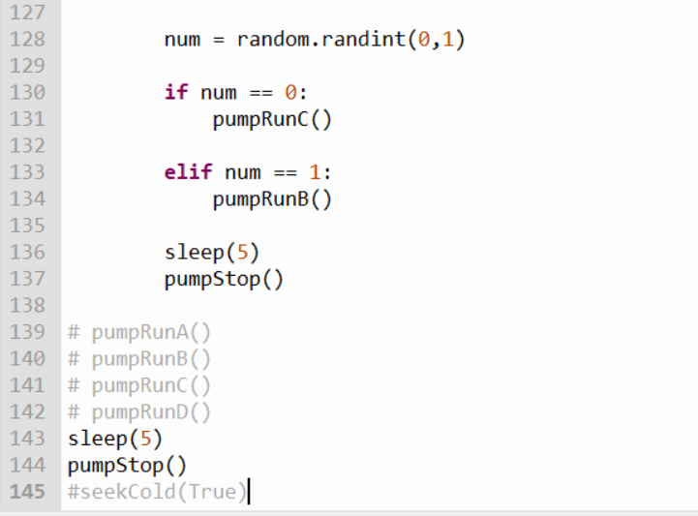
Inside the pump class
Using temperature as an incentive for movement
Adding pseudo randomness to movement

Slide 22

Data Management

Slide 23
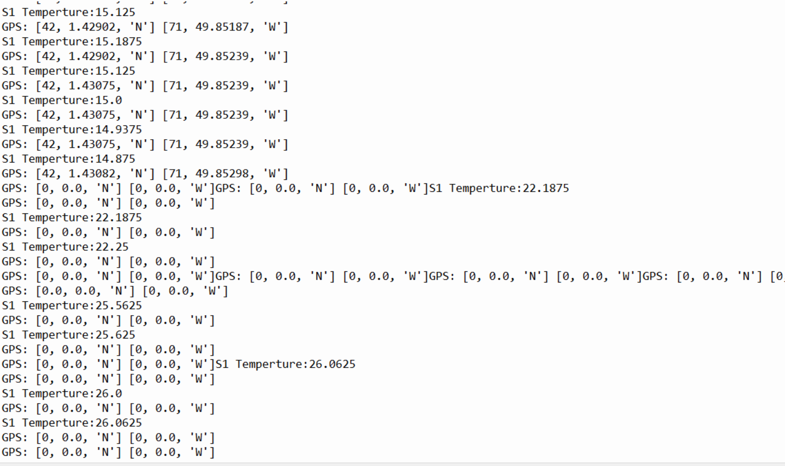
Log info

Slide 24
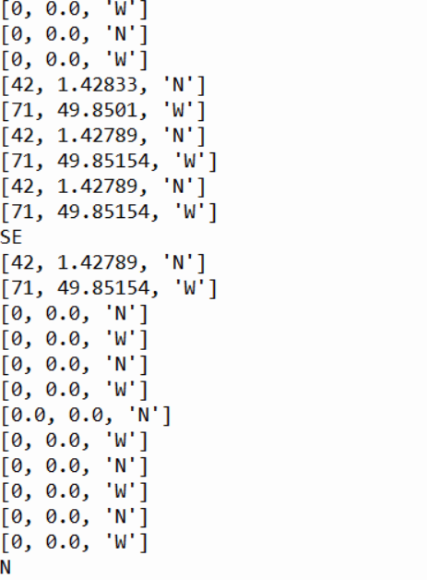
GPS info

Slide 25
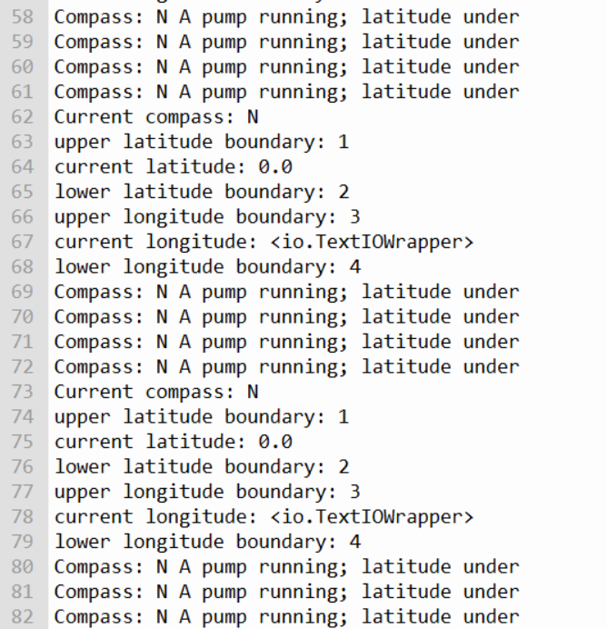
Geofence info

Slide 26
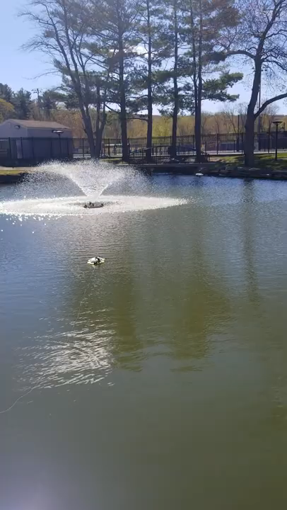

Slide 27
Resources
Thorny Python
Micropython
Open source micropython libraries
Android Studio
Raspberry pi pico tutorials
Python documentation
Android java tutorials
All the code and instructions for this project can be found at https://gitlab.com/jeffersonbourguignon/robotics-and-operating-systems-android-and-automated-probe-water-drone-project

